Slide 1
COVID 19 Hospital Bed Usage Across the U.S
By Anuj Patel

Slide 2
Questions
How many hospital beds have been used due to COVID 19?
How many ICU beds have been used due to COVID 19?
Which regions have been affected the most?

Slide 3
Introduction
Using a dataset found online at healthdata.gov, analysis of total beds and amount used due to COVID 19 was conducted for both inpatient and ICU.
All data was from a cut off date of October 3rd 2020.
All 4 regions in the US (Northeast, Midwest, South, and West) were analyzed.
All analysis was conducted using R.

Slide 4
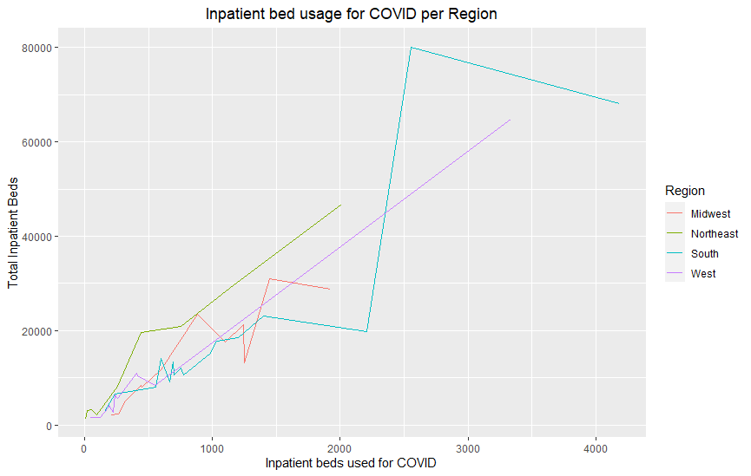
Inpatient beds overall
From this plot we can see that states in the South had the highest number of beds used for COVID 19, followed by states in the West.

Slide 5
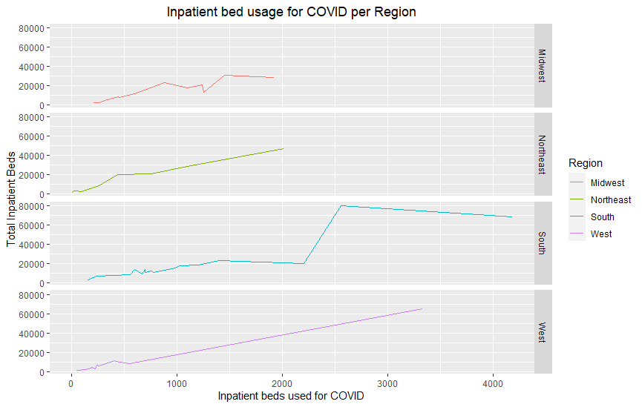
Inpatient beds faceted
Here we can see states in the Midwest had the least amount of patient beds used for COVID 19 with the Northeast not too far behind while also having a higher number of beds available.

Slide 6
Inpatient beds faceted
Here we can see states in the South had the most patient beds used as well as having the most number of beds available. States in the West had the second most number of patient as well as the second most number of beds available.

Slide 7
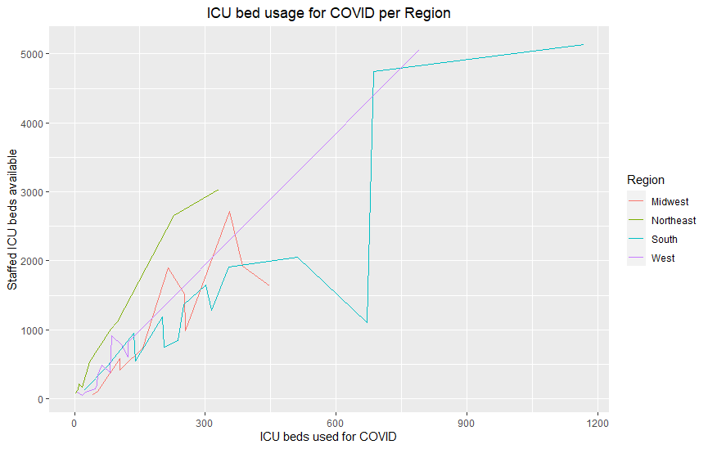
ICU beds overall
Here we can see that states in the South had the most patients in the ICU due to COVID. Perhaps unsurprisingly given that southern states also had the most patients in non-ICU beds.

Slide 8
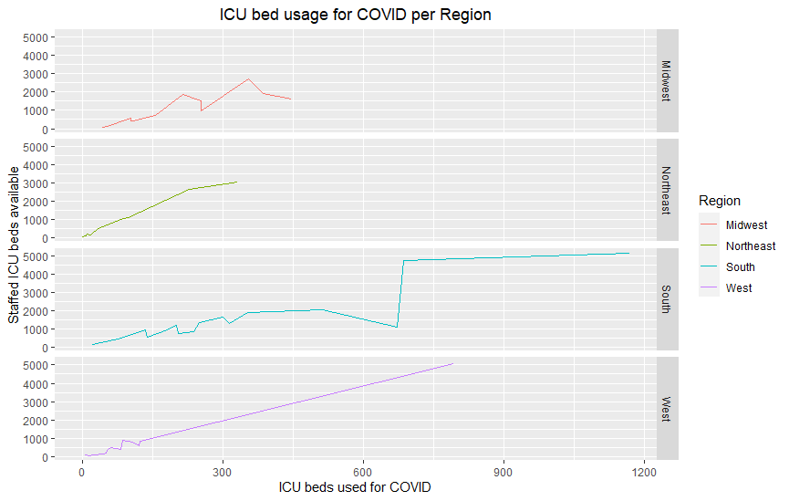
ICU beds facet
Here we can see Midwest and Northeast states had the least amount of patients in ICU with Northeast states having the least.

Slide 9
ICU beds facet
Here we can see states in the South have the most amount of patients in the ICU followed by states in the West.

Slide 10
Notes
Not all hospitals in various states may have reported meaning there could be missing data.
The cutoff for the data was October 3rd 2020 and it’s unclear when compilation of the data began.
The graphs show data for states that make up regions meaning some graphs had rises and dips. Not all states had as many beds used as other states.

